Slide 2


Oracle Cloud | JD Edwards | NetSuite Consulting
Your “peace of mind” partner

Slide 3

Celebrating 28 years
Established in 1994

Slide 4

200+ full-time
employees across the U.S. with an average
of 16+ years experience

Slide 5
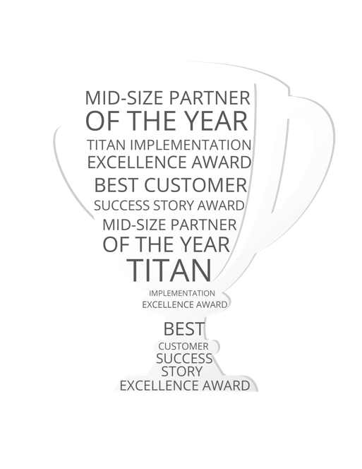
19
Oracle Partner Excellence Awards

Slide 6
700+ clients
across the U.S. have chosen Terillium as their trusted advisor and ERP consulting partner

Slide 7











































Slide 8


Slide 9
